Slide 1
Autonomous Vehicle Edge Detection
Final Project
Yue Wang, Jae Woo Ok, Leanna Hue (Team 3)

Slide 2
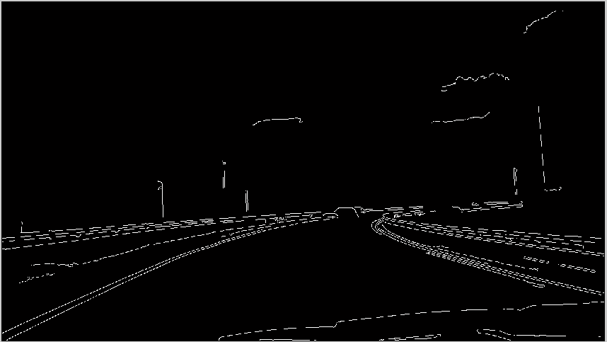
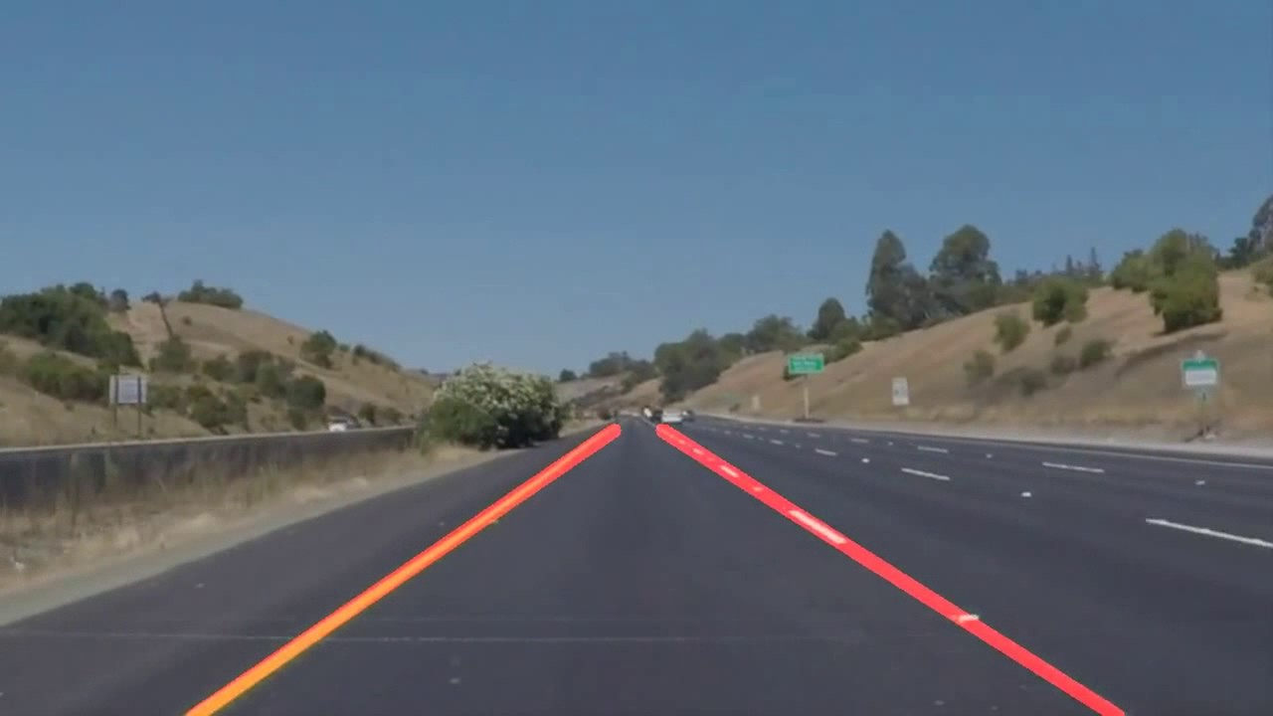
Introduction and Overview
Canny Edge Algorithm Hough Transform

Slide 3
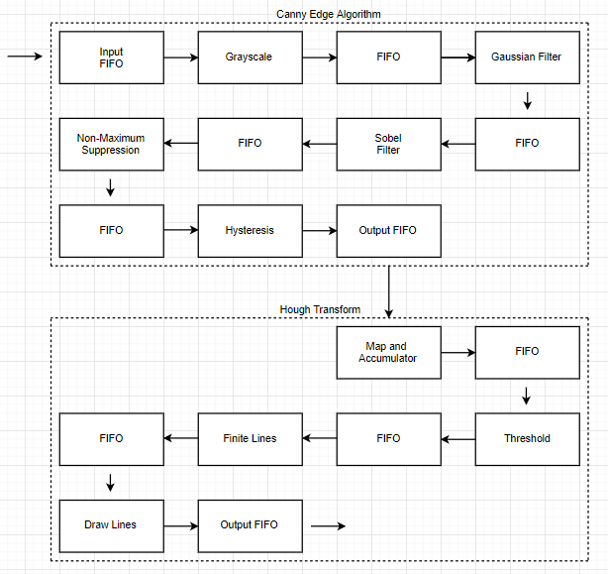
Block Level Overview

Slide 4
Task by Person
Leanna | Jae | Yue
C source code Non-Maximum Suppression Threshold Draw Lines | Grayscale Hysteresis Sobel Filter Finite Lines | Gaussian Filter Canny Edge Top Accumulator Hough Top
Notes:
Original gantt chart -- on track
Will work on making car predictions/movements if finish early

Slide 5
Canny Edge Architecture Overview
FIFO: Memory buffer to temporarily store data
Grayscale: Convert colored image into grayscale
Gaussian: Blurs image using 5x5 matrix
Sobel: Calculates gradients using a 3x3 matrix
Non-Maximum Suppression: Fixes thick white lines so they aren’t as thick
Hysteresis: Keeps pixel if pixel exceeds high threshold, or if pixel exceeds low threshold value and there is one adjacent pixel

Slide 6
Hough Architecture Overview
FIFO: Memory buffer to temporarily store data
Accumulator: Indicates all the lines on the image and represents them in a polar coordinate system. For each pixel, there can be 180 different lines, so it calculates the distance to the central pixel 180 times and adds 1 for the corresponding unit in accumulator
Threshold: Loops over accumulator to get all points whose value is higher than a certain “threshold” value
Finite Lines: Component takes rho and theta value from threshold and converts into endpoints of lines in rectangular coordinate system
Draw Lines: Calculate points on the line and print red pixel for every point

Slide 7
Implementation on the Board
2 Issues that were a problem:
Ethernet/UDP/HDMI function: Our group had trouble with implementing the ethernet/UDP function to get images from the computer to the board, and vice versa using the HDMI function
The original size of the image seemed to make the intermediary buffers and registers too large when we tried to synthesize the design onto the board, so we had to shrink the size of the input and those buffers/registers. In the end, our design was synthesizable but with a 10x10 image

Slide 8
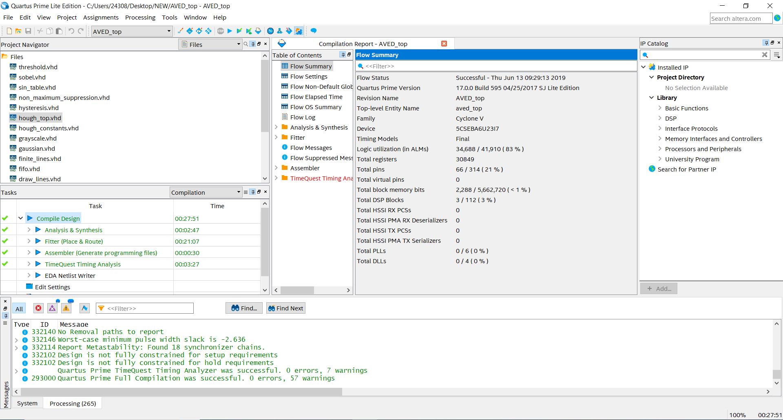
Synthesis Results
Logic Utilization:
34,688/41,910 (83%)
Total Registers:
30,849
Total pins:
66/214 (21%)
Total block memory bits:
2,288/5,662,720 (< 1%)

Slide 9
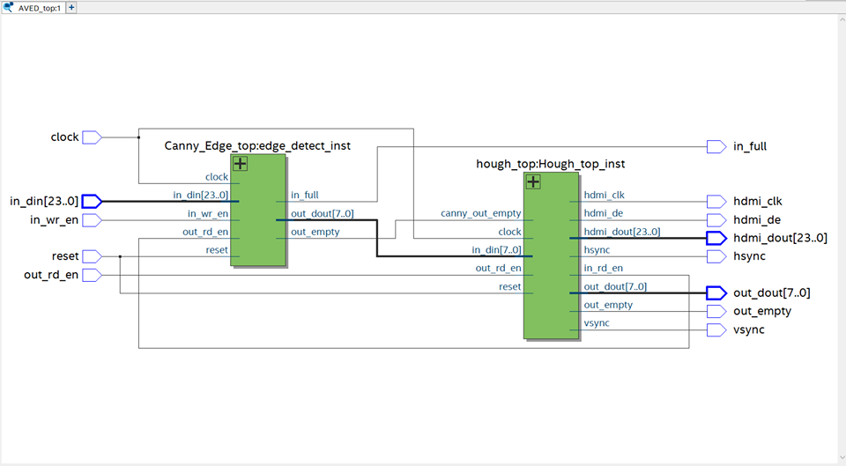
Synthesis Block Diagrams

Slide 10
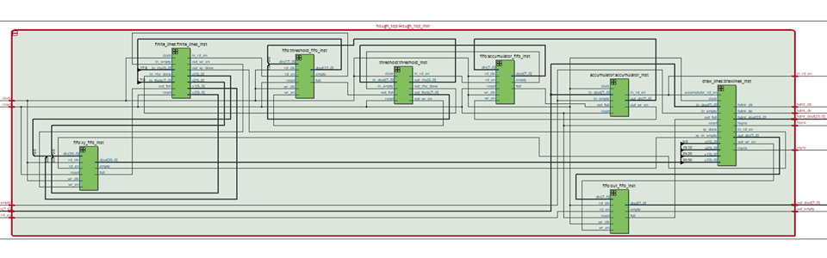
Synthesis Block Diagrams

Slide 11
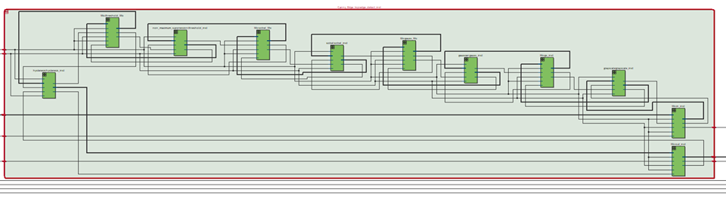
Synthesis Block Diagrams

Slide 12
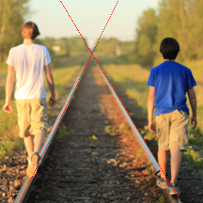

Image Simulation Result of Top Level
Original Image
Output Image

Slide 13
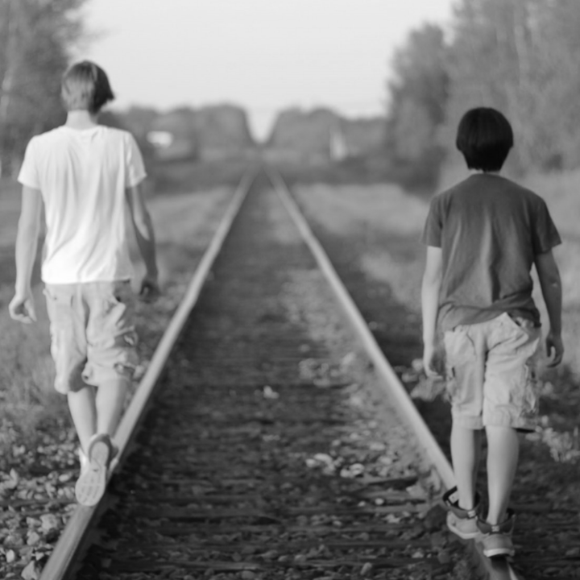

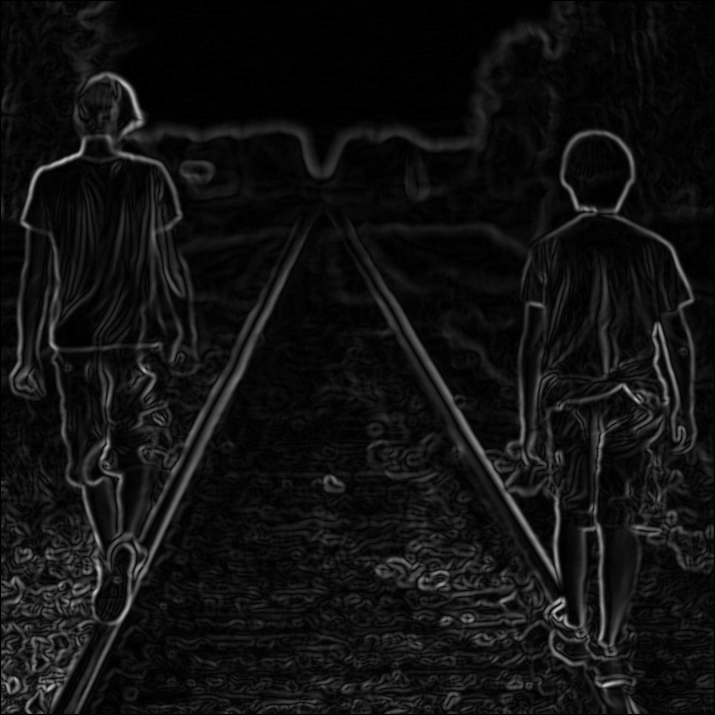
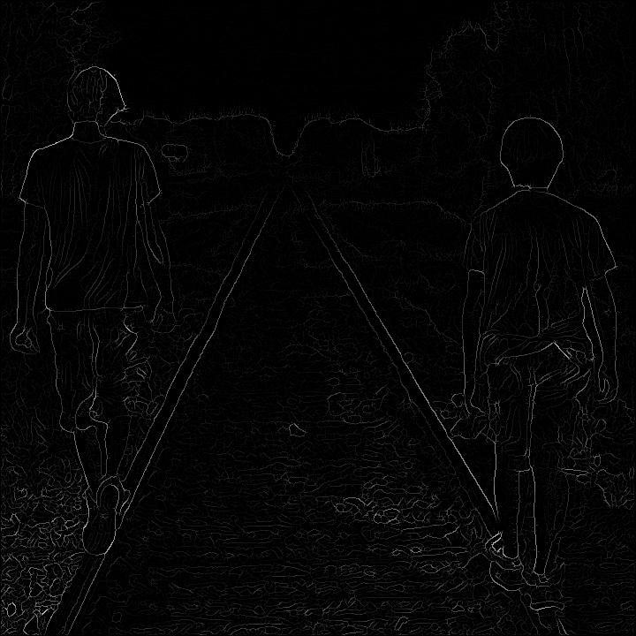
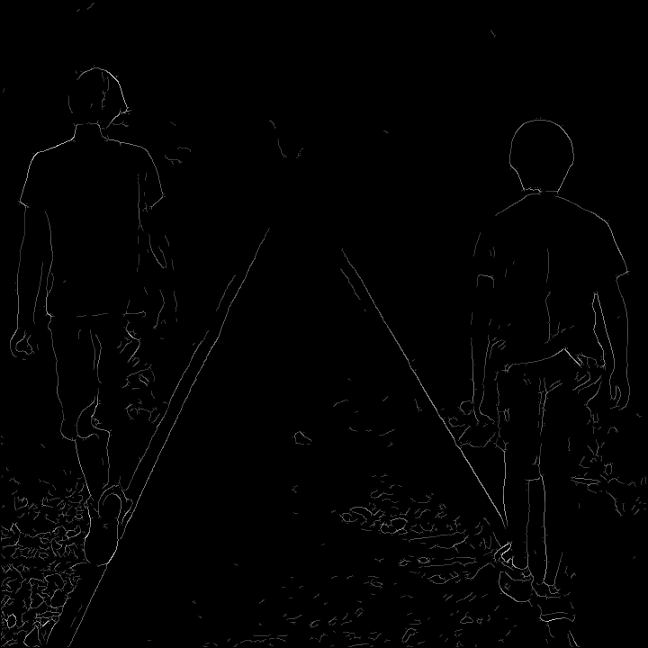
Deliverables (Canny Edge)
Original Image
Step 1: Grayscale
Step 2: Gaussian Blur
Step 3: Sobel Filter
Step 4: Non-maximum suppression
Step 5: Hysteresis
Notes:
Canny edge deliverable
Hough transform deliverable will be similar

Slide 14
Performance and Testing
Test Simulation Results of Top Level

Slide 15
Deliverables (Hough Transform)

Slide 16
Next Steps and Future Work
Optimize Code:
Eg. Remove all “Integer” Types to replace with binary numbers with just the right number of bits.
Pipeline the process with multiple steps
Find a board perhaps with more space to implement our design
Implement Ethernet/UDP/HDMI functions, perhaps with camera

